Slide 1
Film Analytics|
D A T A D A W G S
Siddhant Sutar, Dalton Childers, Neil Matin, Abhimanyu Tomar

Slide 2
INTRODUCTION|
‣ Every year, hundreds of movies are made in USA, with billions of dollars spent in their making and they also gross a huge amount of money.
‣ The Internet Movie Database (IMDb) is an online database that has a weighted mean-rating system for rating movies on a 10-point scale.
‣ For production houses, having a system that could give them possible ratings for a movie based on actor(s), director(s), genre(s), etc. could be of huge value to analyze the cost-benefit of investing in a movie.
‣ Film Analytics, is a project aimed at predicting IMDb movie ratings based on features like actor(s), director(s), genre(s), and plot keyword(s).

Slide 3
DATA|
‣ Dataset: Movie data for ~1.1 million movies obtained from OMDb, stored in a csv file (size: ~500mb).

Slide 4
DATA COLLECTION|
‣ Initially, the data was fetched by making API calls to the OMDb web API and was later stored in a SQLite database. However, the web server restricted us from fetching the data faster.
‣ After making a generous donation to the website owner, we now regularly receive the requested movie data in an unparsed text file monthly.
‣ Since OMDb does not feature retrieval of box-office data, we personally web-scraped iMDB to fetch the same data.

Slide 5
DATA PREPROCESSING|
‣ To start off with, the text files are parsed into a readable format.
‣ Movies with genres such as Adult, Documentary as well as television events disguised as movies corresponding to genres such as Reality-TV, Talk Show, etc. are filtered out to remove noise and redundancy.
‣ Similarly, made-for-television movies are also filtered out using the Rating column. Movies with Rating starting with TV, for example, TV-13, are filtered out.
‣ Despite being a huge library of movies, iMDB does not have all the required data for a large chunk of the movies. This makes it impossible to filter out television movies as well as other television services such as pay-per-views.

Slide 6
DATA PREPROCESSING|
‣ For the sake of our project, we stuck with only movies based in USA, since they have a greater proportion of the complete data.
‣ Thus, out of a total of 1103922 movies, 71565 movies were taken for our model.

Slide 7
STATISTICS|
‣ Total movies: 1103922
‣ Movies in our model (USA only): 71565 (training + test)
‣ Actors: 76440 (training)
‣ Directors: 20962 (training)
‣ Plot keywords: 60376 (training)
‣ Movies with box-office budget data: 15556 (training + test)
‣ Movies with box-office gross data: 4205 (training + test)
‣ Movies with box-office data: 4201 (training + test)

Slide 8
VARIABLES|
‣ Independent variables (features):
Genre(s)
Director(s)
Actor(s)
Plot keyword(s)
‣ Dependent variable (outcome):
iMDB rating

Slide 9
FEATURE ENGINEERING|
‣ Since all the independent variables here are categorical, not continuous, need to convert the categorical variables into a form that “makes sense” to regression analysis.
‣ All the independent variables are categorical; this is also known as an analysis of variance (ANOVA).
‣ Basically need to numerically represent the categories of a variable, called dummy variables, data coded according to 0 and 1 scheme.
‣ Interpretation: transform a variable such as Genre, which consists of categorical values such as Action, Drama, etc. into a feature matrix with scores of 1 and 0 that can be analyzed with regression.

Slide 10
FEATURE ENGINEERING|
‣ As such, before proceeding to “apply” machine learning, we need to create feature vectors for the independent variables: genre(s), director(s), actor(s), and plot keyword(s).
‣ A typical feature vector for actors would be a sparse matrix that would have movie IDs as rows and list of actors (from the movies in the dataset) as columns (dummy variables). If a specific actor was present in a specific movie, their intersection would have value 1; 0 otherwise.
‣ To handle memory efficiently and to take advantage of the sparse structure of these matrices, we are storing them in Compressed Row Storage (CSR) format.

Slide 11
MACHINE LEARNING|
‣ Our data is supervised; each movie in the data has its own rating. Thus, each movie is labeled. The obvious approach was to proceed with supervised learning.
‣ Supervised learning is further subdivided into two categories, where the dependent variable can be either continuous or categorical.
‣ Continuous supervised learning deals with regression analysis while categorical supervised learning deals with statistical classification that can be later further incorporated into a regression model.

Slide 12
MACHINE LEARNING|
‣ For our project, we have particularly delved into understanding about both the approaches to learn about the predictive improvements. The following are the two machine learning algorithms that were used:
Multiple linear regression (linear regression)
Ordered logistic regression (classified non-linear regression)

Slide 13

LINEAR REGRESSION|
‣ Simple linear regression is an approach for predicting a quantitative response using a single feature (or "predictor" or "input variable"). It takes the following form:
What does each term represent?
y is the response
x is the feature
β0 is the intercept
β1 is the coefficient for x
Together, β0 and β1 are called the model coefficients. To create our model, you must "learn" the values of these coefficients. And once we've learned these coefficients, we can use the model to predict the iMDB movie ratings.

Slide 14
MULTIPLE LINEAR REGRESSION|
‣ Simple linear regression can easily be extended to include multiple features. This is called multiple linear regression:

Slide 15
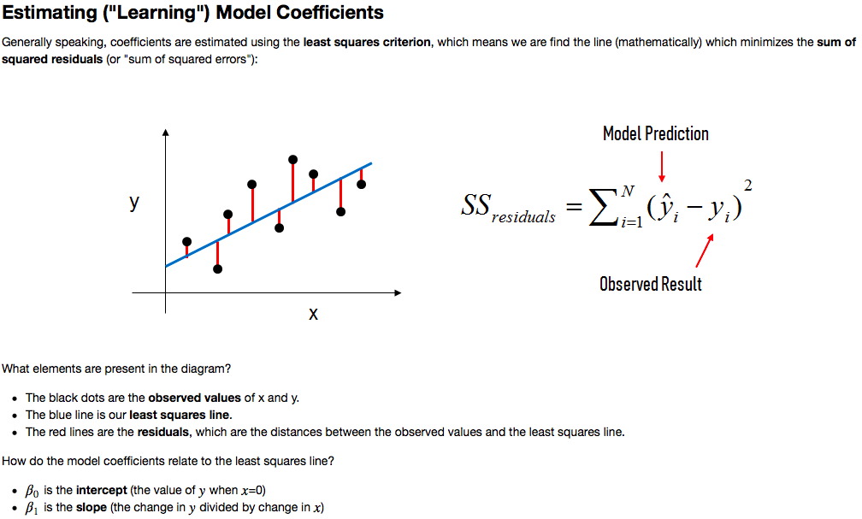
ESTIMATING MODEL COEFFICIENTS|

Slide 16
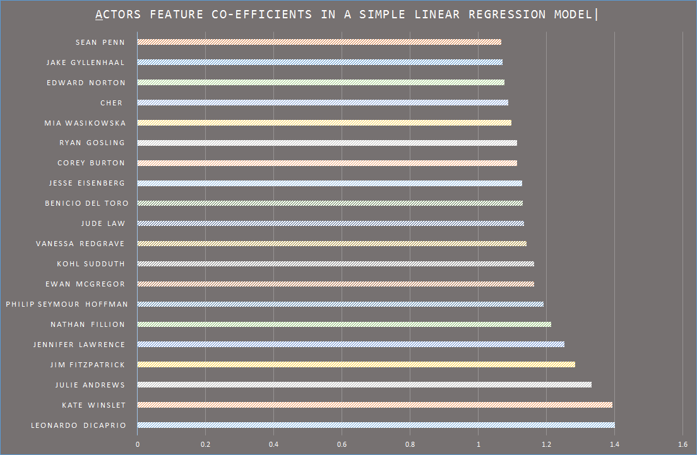
TRENDS|

Slide 17
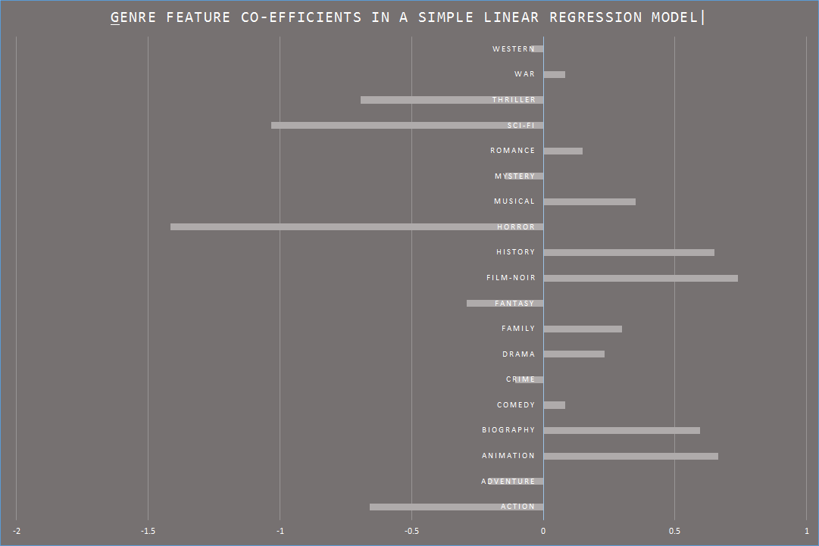
TRENDS|

Slide 18
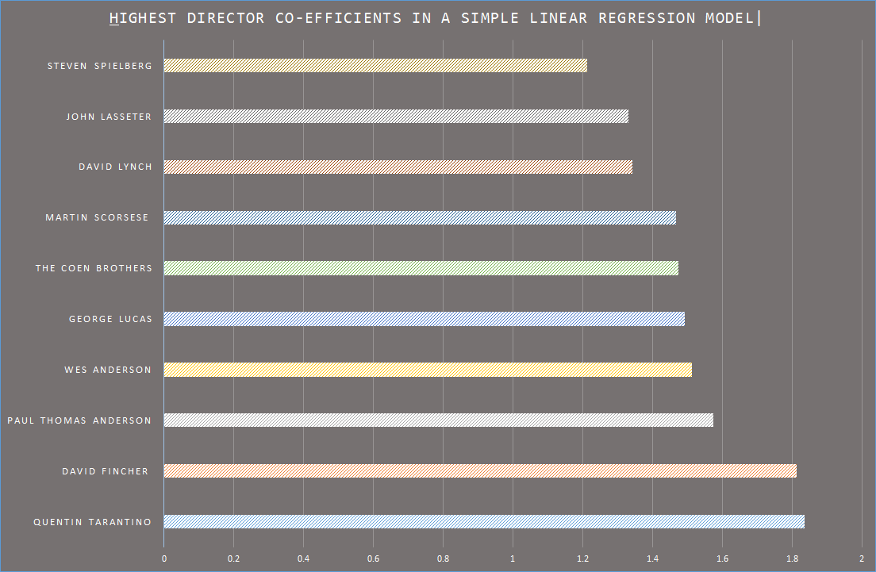
TRENDS|

Slide 19
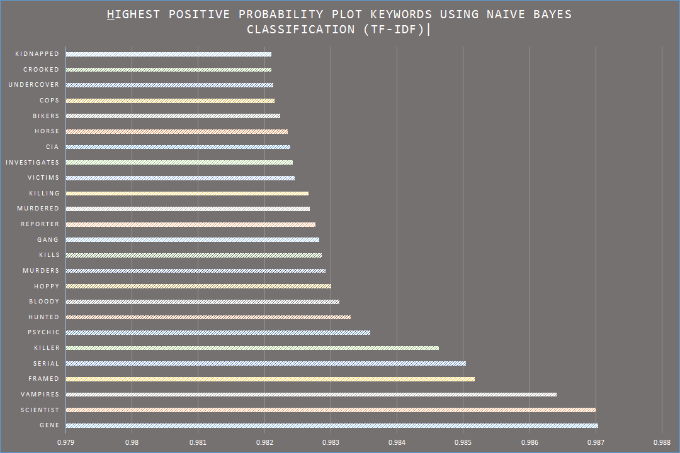
TRENDS|

Slide 20
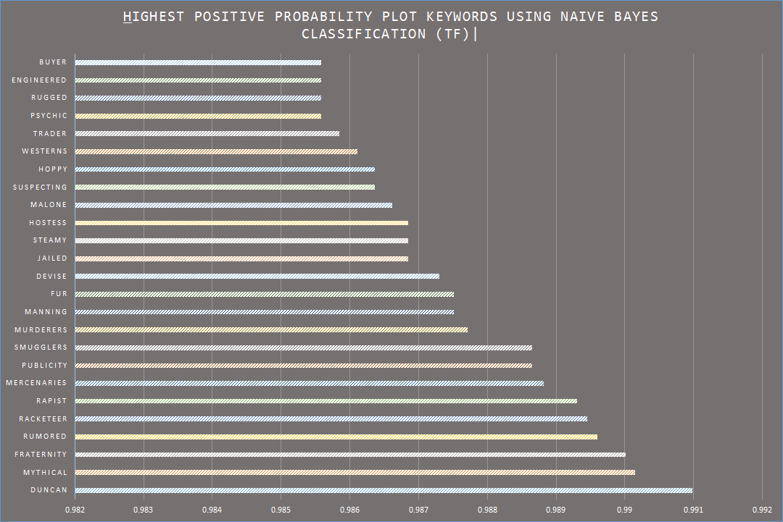
TRENDS|

Slide 21
MULTIPLE LINEAR REGRESSION MODEL|
‣ The independent variables would be the specified actor(s), director(s), genre(s), and plot keyword(s) with their feature values (x_{n}) equal to 1.
‣ Cross-validation: for our analysis, we are using a 70-30 training-test split.

Slide 22
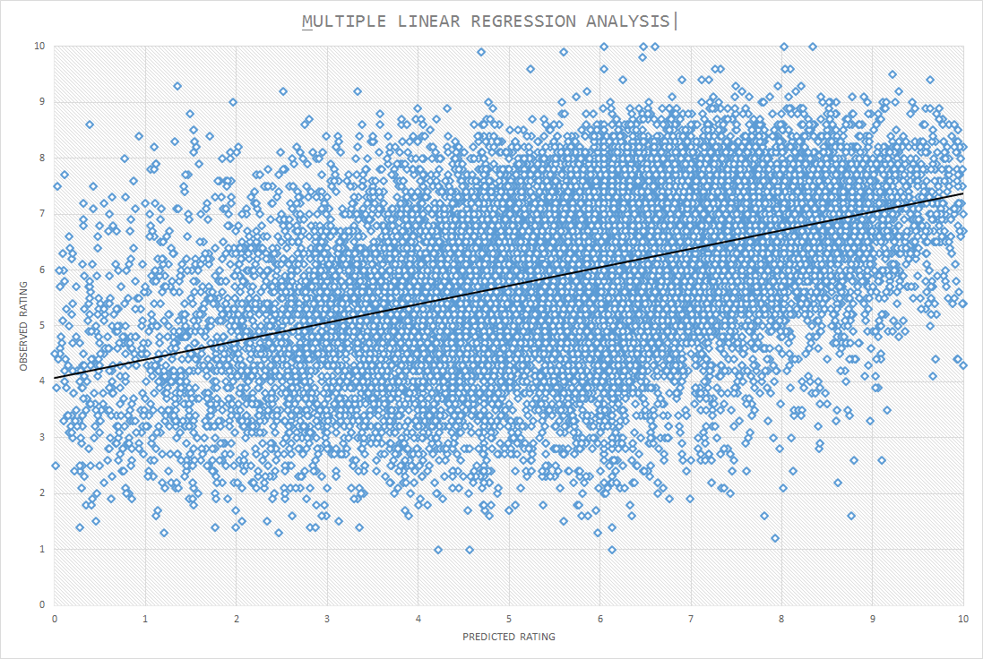
OBSERVATIONS|

Slide 23
OBSERVATIONS|
‣ Scatter points closely lying around the line of best-fit (black line), indicating a correlation between the observed and the predicted ratings.
‣ R-squared Error: 0.2121
‣ Tolerance: 79%
‣ Standard Error: 0.0045
‣ Root Mean Squared Error (RMSE): 1.764
‣ Mean Absolute Error (MAE): 1.370

Slide 24
ISSUES|
‣ Scaling: the outcome rating with certain predictors crosses the 10 point mark.
‣ Linear regression treats movie rating as a continuous variable (can go below zero or above ten), whereas essentially it is a categorical ordered variable; hence the need to implement ordered logistic regression.

Slide 25
LOGISTIC REGRESSION|
‣ Logistic regression deals with dependent variables that are categorical.
‣ Logistic regression measures the relationship between the categorical dependent variable and one or more independent variables by estimating probabilities using a logistic function, which is the cumulative logistic distribution.

Slide 26
ORDERED LOGISTIC REGRESSION|
‣ Ordinal logistic regression (also known as ordered logit model) is a regression model for ordinal dependent variables.
‣ An ordinal variable is similar to a categorical variable, the difference lying in the fact that there is a clear ordering of the variables.

Slide 27
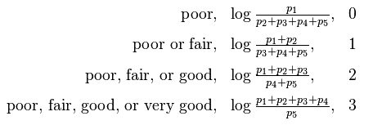
ORDERED LOGISTIC REGRESSION|
‣ Let us consider an example. Say the proportion of members of the statistical population who would answer poor, fair, good, very good and excellent are p₁ , p₂ , p₃ , p₄ and p₅ , respectively. Then the logarithms of the odds of answering in certain ways would be:

Slide 28
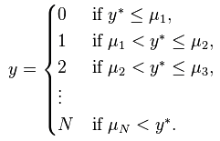
ORDERED LOGISTIC REGRESSION|
‣ Suppose the underlying process to be characterized is:
where y* is the exact but unobserved variable, x’ is the vector of independent variables and β is the vector of regression coefficients. We cannot observe y*, only the categories:
Then this technique uses observations on y which are a form of censored data on y* to fit the parameter vector β

Slide 29
ORDERED LOGIT MODEL|
‣ The basic framework of the model and the feature engineering is the same as the linear regression model: creating feature vectors for the categorical independent variables.
‣ The only change is that the iMDB ratings are treated as an ordered categorical variable instead of a continuous numeric value.
‣ The order is as follows:
0 = [0, 5), 1 = [5, 6), 2 = [6, 7), 3 = [7, 8), 4 = [8, 9), 5 = [9, 10]
‣ Cross-validation: for our analysis, we are using a 70-30 training-test split.

Slide 30
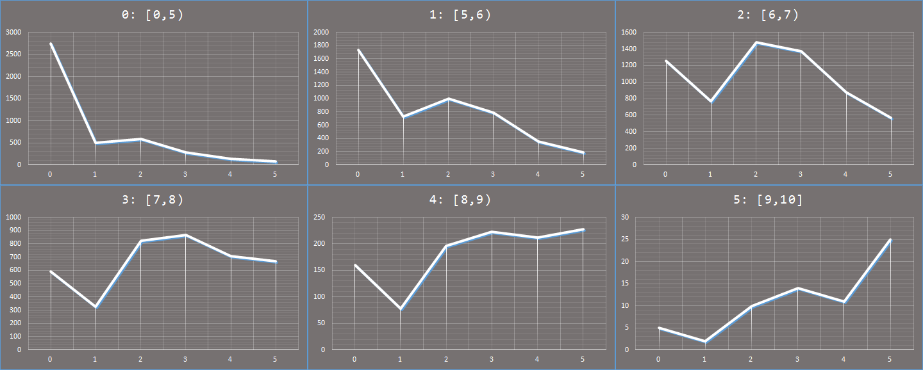
OBSERVATIONS|
‣ Predicted ordered rating vs. number of predictions for each actual ordered rating

Slide 31
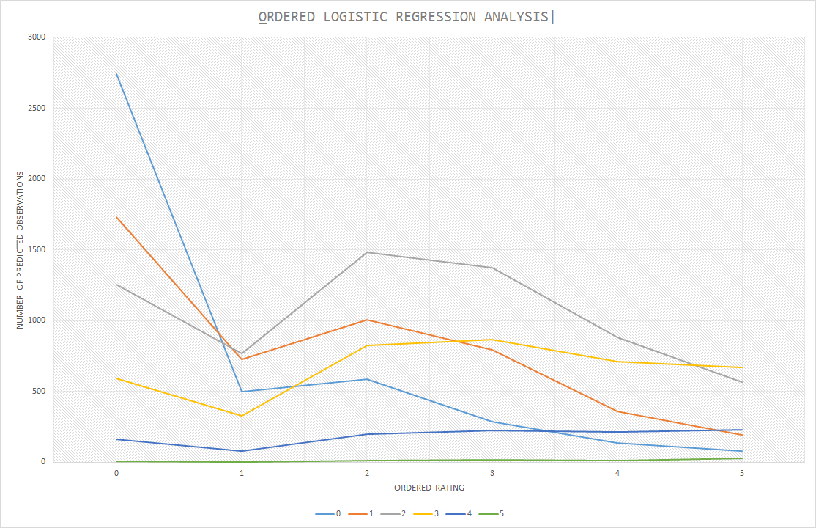
OBSERVATIONS|

Slide 32
OBSERVATIONS|
‣ Root Mean Squared Error (RMSE): 1.606
‣ Mean Absolute Error (MAE): 1.206

Slide 33
ISSUES|
‣ Scikit-learn or even any other prominent machine learning libraries such as Statsmodel do not support a standalone module for ordered logistic regression yet, thereby arising the question of standardization of analysis results.
‣ We are using a user-written ordered logistic module (made by Fabian Pedregosa, obtained from his GitHub repository).

Slide 34
SIDE-BY-SIDE COMPARISON|
 | ‣ Linear Regression | ‣ Logistic Regression
RMSE | 1.764 | 1.606
MAE | 1.370 | 1.206

Slide 35
CONCLUSION|
‣ Ordered logistic regression performed better than multiple linear regression, based upon RMSE and MAE estimators.
‣ An R-squared value of 0.21 for linear regression indicates a very low correlation; however, it can be possibly argued that for real-world data it is relatively high as the model is able to explain 20% of the variation.

Slide 36
CHALLENGES|
‣ Data acquistion was the bottleneck for the longest time; making individual API calls from a machine with limited processing capabilities to a server with frequent overloads.
‣ Deciding upon what machine learning algorithms to choose for analysis, taking into consideration the limited processing capabilities and the timeframe of the project.

Slide 37
FUTURE PLANS|
‣ Consider some more machine learning models, such as Support Vector Machines (SVMs), to get the estimation of the best model for our predictor system.
‣ Addition of more relevant features like time of release, budget, as well as analyzing user movie reviews, social network data, Google trends, etc. could possibly help the model predict more accurately.
‣ Incorporate movies beyond the ones based in USA, provided complete information is present in the dataset.
‣ Develop a web front-end.

Slide 38
CONTRIBUTIONS|
‣ Siddhant: machine learning model design and data mining
‣ Dalton: data acquisition and infrastructure
‣ Neil: machine learning research
‣ Abhimanyu: machine learning research

